Slide 1
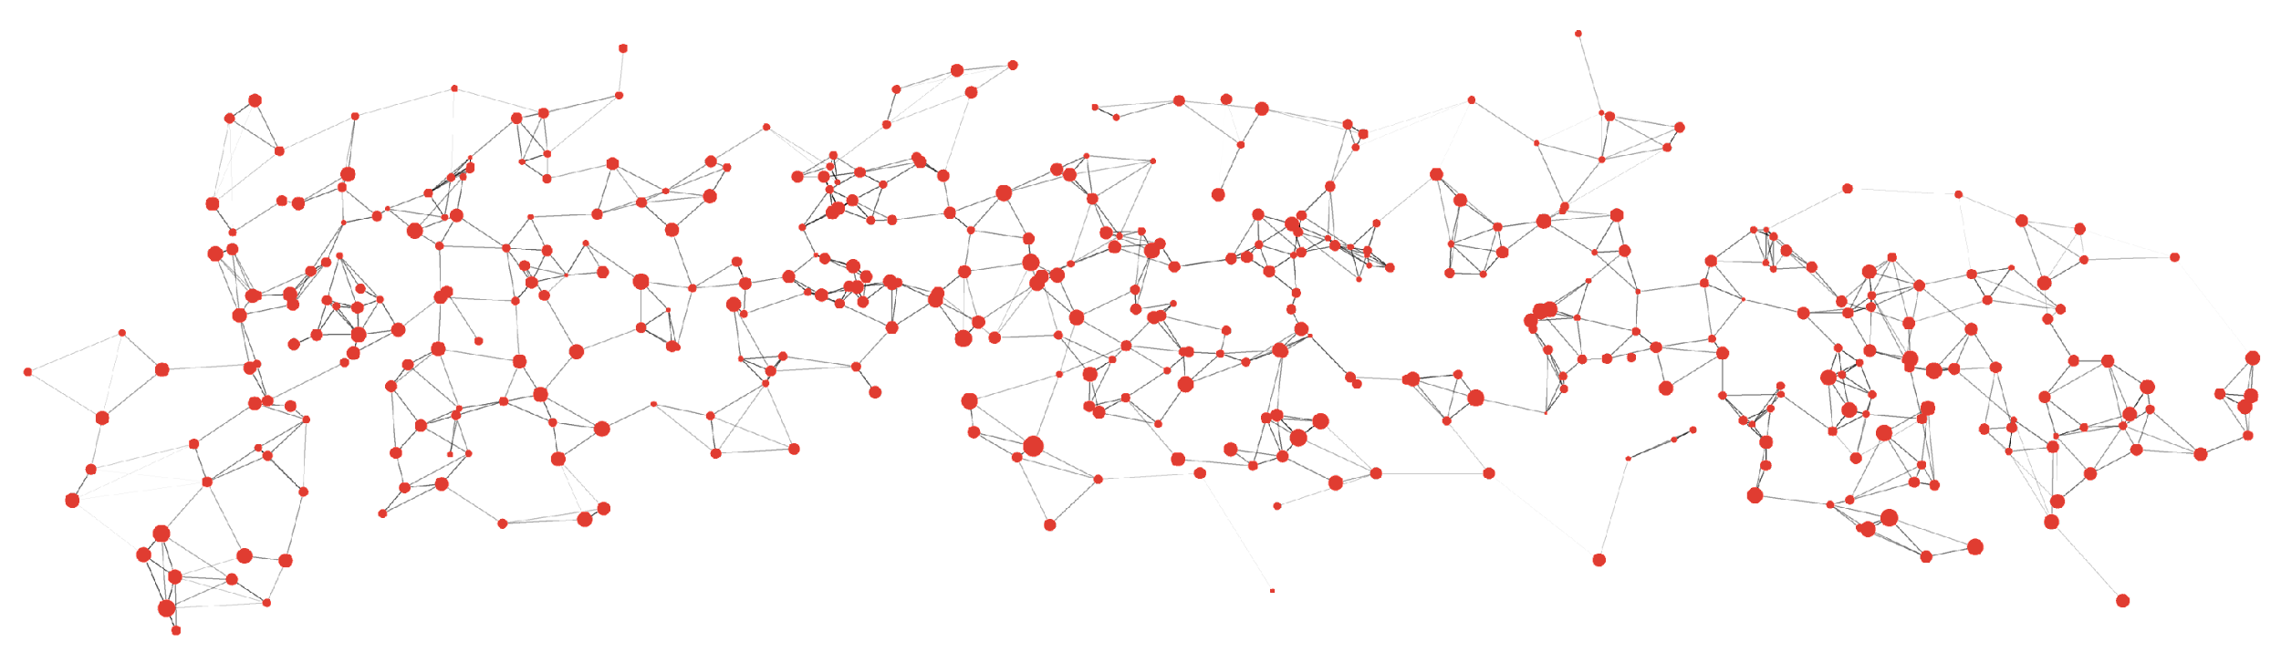


Generalized pairwise comparisons: A practical guide to the design and analysis of patient-centric trials
Johan Verbeeck PhD
johan.verbeeck@uhasselt.be
Data Science Institute
UHasselt - Belgium
Brice Ozenne PhD
brice.ozenne@nru.dk
Biostatistics & Neurobiology Research Unit
University of Copenhagen- Denmark

Slide 2
Author disclosures
We declare no conflicts of interest

Slide 3
Agenda
Motivating examples
Time-to-first event
Benefit-risk assessment
Multivariate outcomes of different types
Concept of GPC

Slide 4

Agenda
Motivating examples
Time-to-first event
Benefit-risk assessment
Multivariate outcomes of different types
Concept of GPC
Introduction to the package BuyseTest
Measures of treatment effect
Statistical inference
Examples, revisited

Slide 5
Agenda
Motivating examples
Time-to-first event
Benefit-risk assessment
Multivariate outcomes of different types
Concept of GPC
Introduction to the package BuyseTest
Measures of treatment effect
Statistical inference
Examples, revisited
Advanced Topics
Censoring
Covariate adjustment
Trial design

Slide 6
Motivating examples

Slide 7
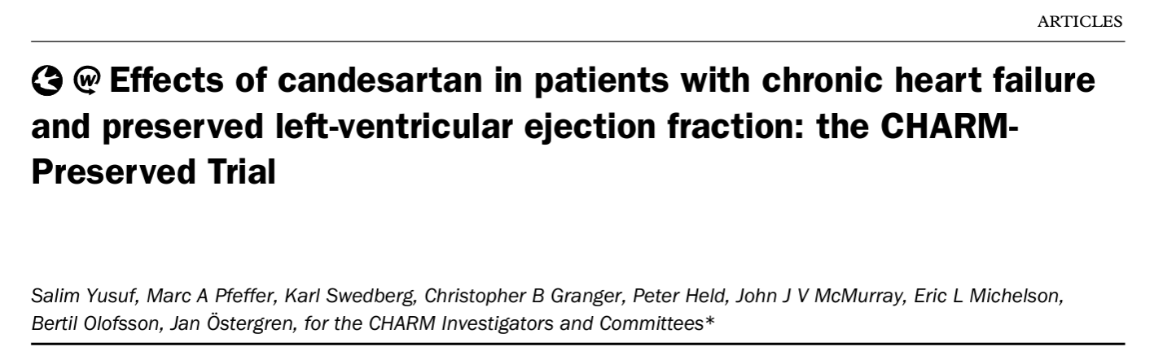
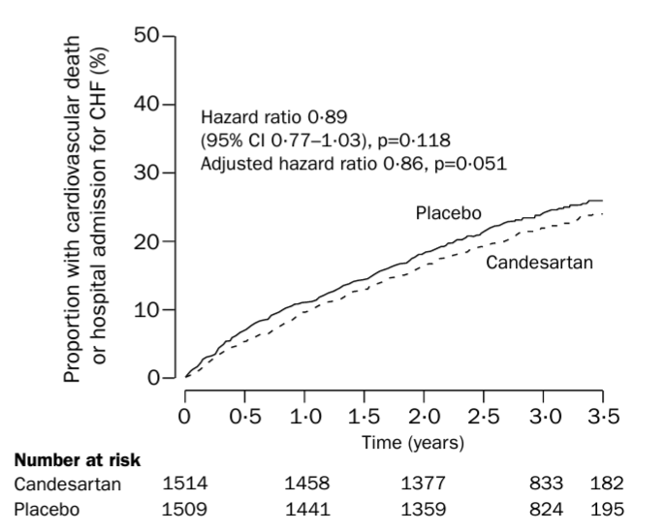
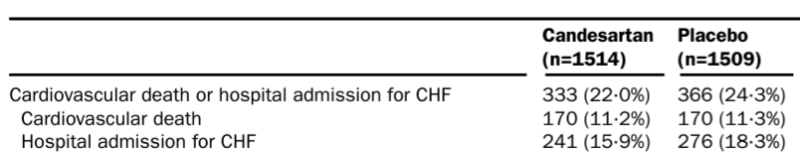
1. Composite of survival outcomes
Yusuf et al. Lancet (2003)
Notes:
an angiotensinreceptor blocker, candesartan, would be of benefit in patients with CHF and preserved LVEF

Slide 8
Issues with time-to-first event analyses
Events in time-to-first event composite
Candesartan Placebo
92 (54%) 90 (53%)
241 (100%) 276 (100%)
46% (158/340) of CV deaths are ignored
Yusuf et al. Lancet (2003)
Notes:
composite != sum of events; so several pts with more than 1 event; which means deaths are ignored (cannot ignore hopsitalization of course)
46% not used – but clinically most important

Slide 9
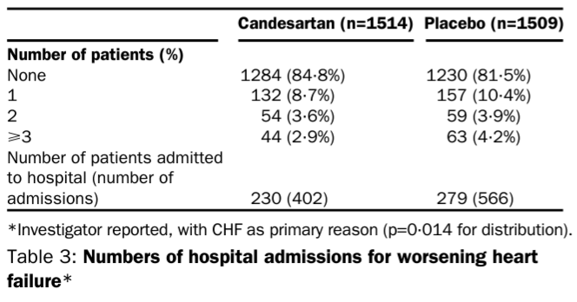
Issues with time-to-first event analyses
Emphasis is on time of event, rather than severity of event; i.e. a patient that has an hospitalization is worse than a patient dying 1 day later
Ignores repeated events (cannot count events; f.e. # hospitalizations)
Verbeeck et al. JACC (2023)
Verbeeck et al. EHJ:ACVC (2024)
Yusuf et al. Lancet (2003)

Slide 10
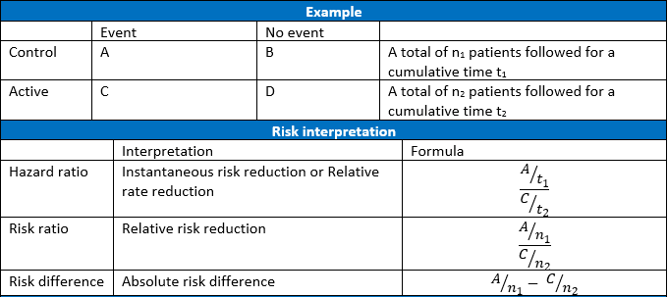
Issues with hazard ratio
Misinterpretation:
HR is time-dependent unless the hazard rates are proportional over time
Verbeeck et al. JACC (2023)
Verbeeck et al. EHJ:ACVC (2024)
Notes:
HR= ratio of the hazard rates (=instantaneous risk)
= a rate ratio or a relative rate reduction
≠ relative risk reduction

Slide 11
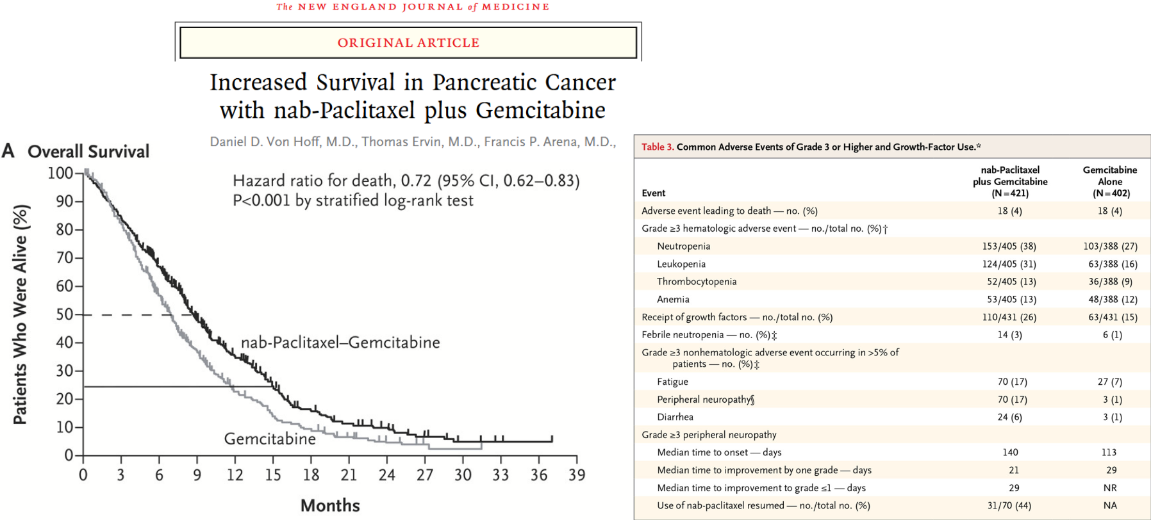
2. Benefit-Risk assessment
Do survival benefits outweigh the burden of the adverse-events?

Slide 12
Marginal Benefit-Risk analyses
Traditional analysis:
Benefit: log-rank test
difference in 1 year survival
example: 50% vs. 20%
Risk: chi-squared test
difference in proportion of patients
with events of grade 3 or higher
example: 30% vs 0%
ignores a possible association between benefit and risk
a) positive association: side effects may only occur when it prolongs life (never purely harmful treatment).
b) no association: treatment with two independent mechanisms, one acting on survival and another generating side effects.
c) negative association: treatment solely beneficial for some patients while solely harmful for other patients.

Slide 13
Benefit-Risk association
Treatment group (scenario a) |  | Response
 |  | Absent | Present | Total
Toxicity | Absent | 0.5 | 0.2 | 0.7
 | Present | 0 | 0.3 | 0.3
 | Total | 0.5 | 0.5 | 1
benefit: 0.3 vs. 0.3
Control group |  | Response
 |  | Absent | Present | Total
Toxicity | Absent | 0.8 | 0.2 | 1
 | Present | 0 | 0 | 0
 | Total | 0.8 | 0.2 | 1
- - - short life with toxicity | - short life without toxicity | + long life with toxicity | + + + long life without toxicity

Slide 14
Benefit-Risk association
Treatment group (scenario a) |  | Response
 |  | Absent | Present | Total
Toxicity | Absent | 0.5 | 0.2 | 0.7
 | Present | 0 | 0.3 | 0.3
 | Total | 0.5 | 0.5 | 1
benefit: 0.3 vs. 0.3
Control group |  | Response
 |  | Absent | Present | Total
Toxicity | Absent | 0.8 | 0.2 | 1
 | Present | 0 | 0 | 0
 | Total | 0.8 | 0.2 | 1
Treatment group (scenario b) |  | Response
 |  | Absent | Present | Total
Toxicity | Absent | 0.35 | 0.35 | 0.7
 | Present | 0.15 | 0.15 | 0.3
 | Total | 0.5 | 0.5 | 1
unclear: 0.15 + 0.15 + 0.15 vs 0.45
Treatment group (scenario c) |  | Response
 |  | Absent | Present | Total
Toxicity | Absent | 0.2 | 0.5 | 0.7
 | Present | 0.3 | 0 | 0.3
 | Total | 0.5 | 0.5 | 1
unclear: 0.3 + 0.3 vs 0.6
- - - short life with toxicity | - short life without toxicity | + long life with toxicity | + + + long life without toxicity

Slide 15
Sensible Benefit-Risk analyses
Benefit-risk balance depends on the association between response and toxicity
Traditional (marginal) analysis ignore this association
- marginal benefits and marginal risks cannot be combined (without strong assumptions)
- interpretation of the results is difficult
Upon deciding on a hierarchy of outcomes, e.g.:
a joint analysis of the benefit and the risk will provide value information.
- - - short life with toxicity | - short life without toxicity | + long life with toxicity | + + + long life without toxicity

Slide 16
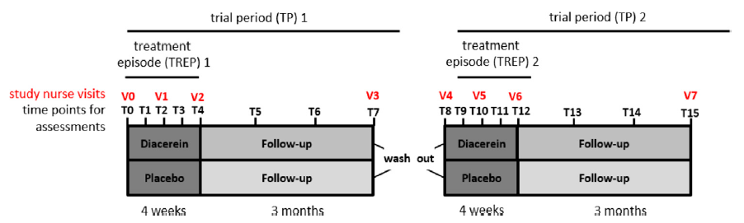
3. Multivariate outcomes of different types
Rare skin disease: Epidermolysis bullosa simplex
Formation of blisters under low mechanical stress
16 pediatric subjects treated with placebo and diacerin cream in a longitudinal cross-over trial
Wally et al. J Am Acad Dermato (2018)
Notes:
Cytoskeleton protein misfolded – missing data – post 4 week Tx effect – blister reduction >40% (binary outcome) – difference in QoL (ctu)
Not specific for prioritized endpoints, but GPC

Slide 17
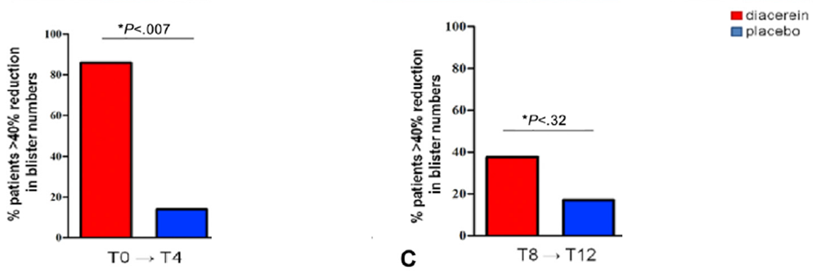
Inconclusive results - primary endpoint analysis
Primary endpoint:
>40% reduction in blisters compared to baseline (binary outcome ) at week 4
Barnard test (~Fisher exact test 2x2 table) per treatment period
Wally et al. J Am Acad Dermato (2018)
Notes:
Longitudinal cross-over analyses with small samples in itself is an interesting problem, we’ll focus on a different issue

Slide 18
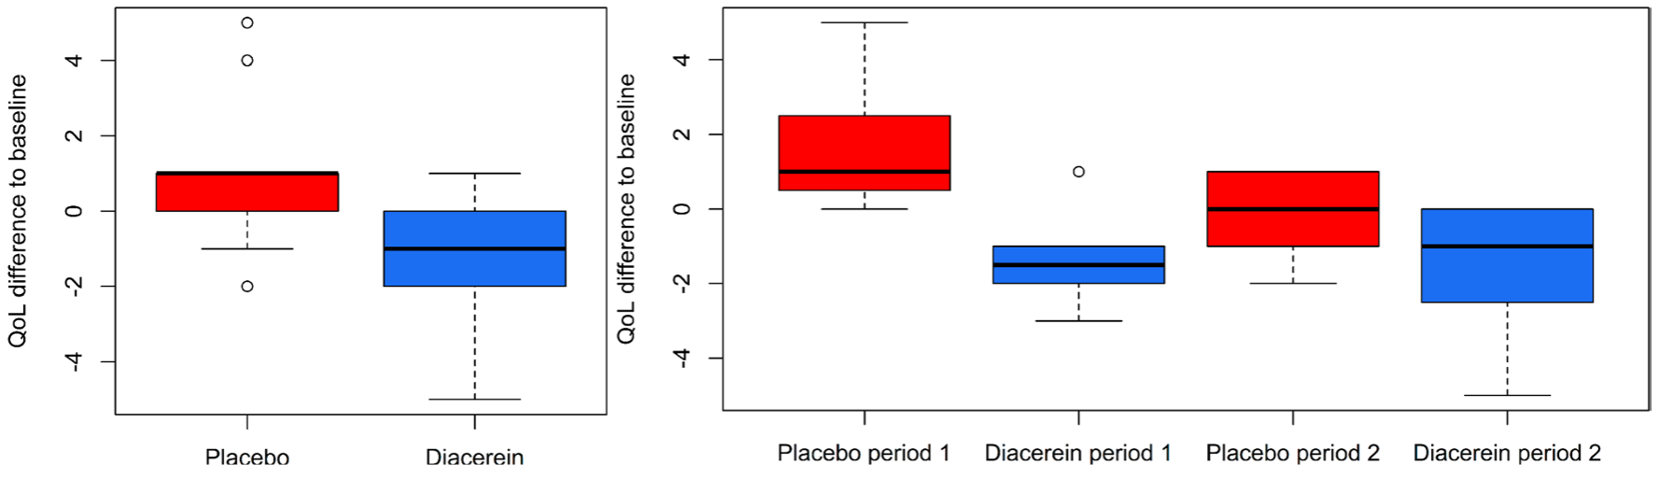
Patient-centric outcome ignored
Formation of blisters under low mechanical stress – affects QoL
How to combine information from QoL with blister information?
Wally et al. . J Am Acad Dermato (2018)
Verbeeck et al. OJRD (2023)

Slide 19
Concept of GPC

Slide 20
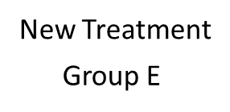
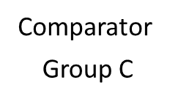
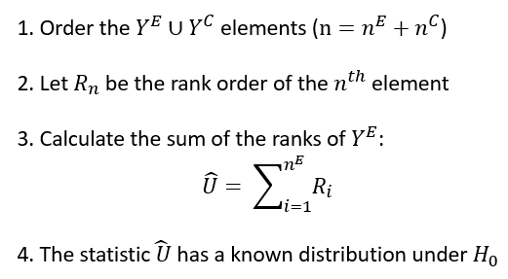


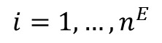
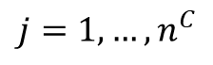
Wilcoxon rank-sum test
Wilcoxon. Biometrics (1945)

Slide 21
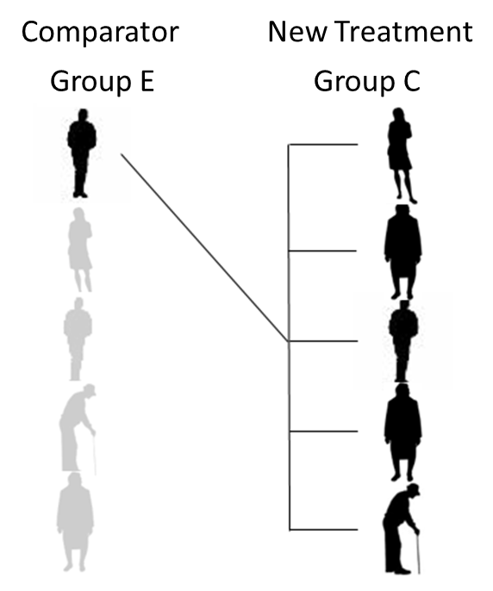
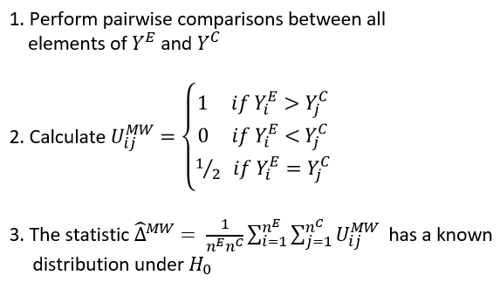
Mann-Whitney test
Mann & Whitney. Ann Math Stat (1947)

Slide 22

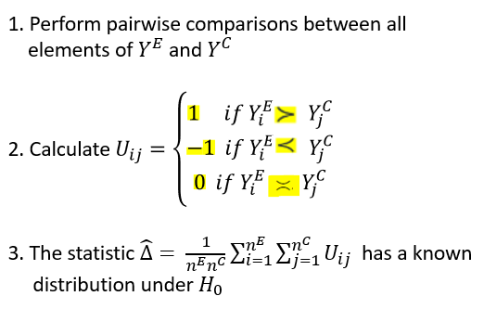
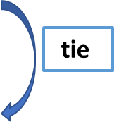
Generalized Pairwise Comparisons (GPC)
Highest ranked outcome
Middle ranked outcome
Lowest ranked outcome
Note: priorities may be patient-centric
Buyse. Stat Med (2010)
Pocock et al. Eur Heart J (2012)

Slide 23
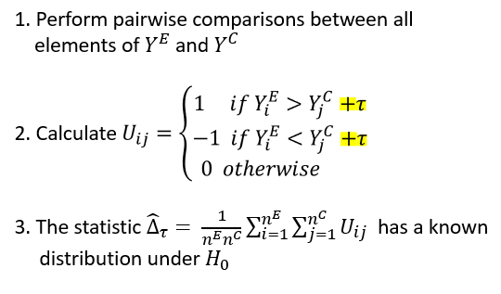
GPC – threshold of clinical similarity
Buyse. Stat Med (2010)

Slide 24
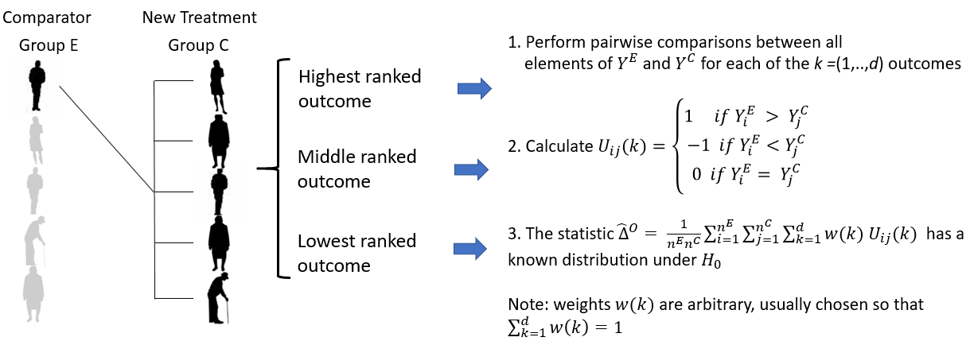
GPC – multiple weighted outcomes
O’Brien. Biometrics (1984)

Slide 25
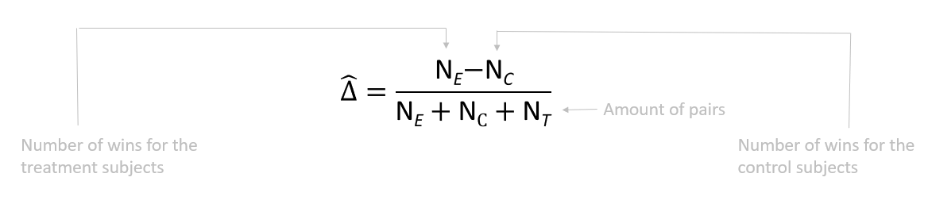
GPC statistics
Net treatment benefit (NTB)
Is a U-statistic
Buyse. Stat Med (2010)
Hoeffding. Ann Math Stat (1948)

Slide 26
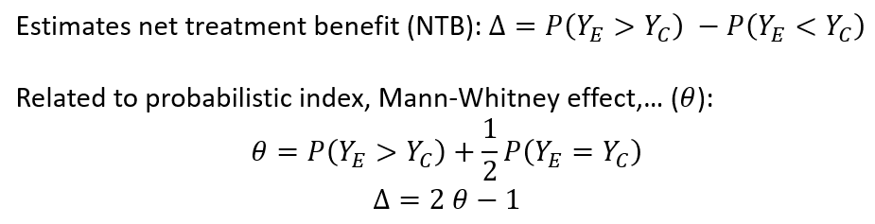
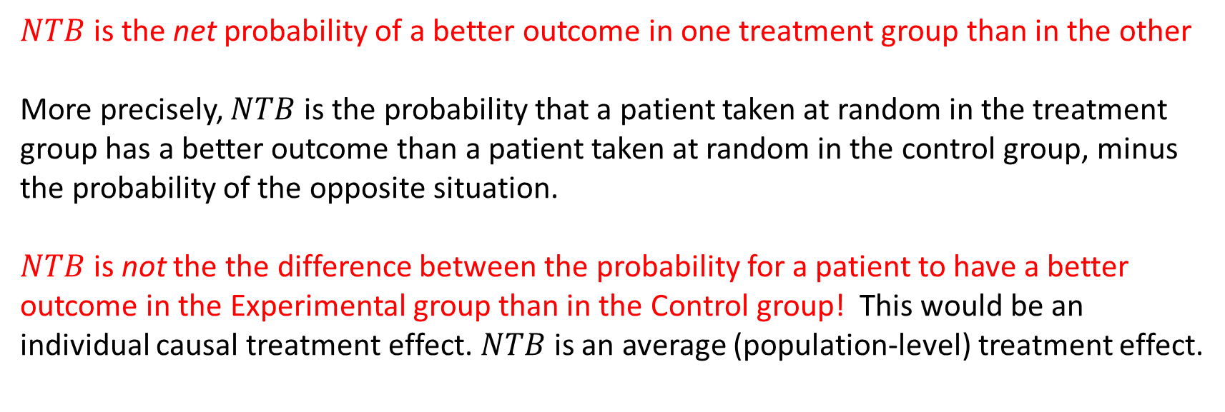
GPC statistics - Net treatment benefit
Buyse. Stat Med (2010)

Slide 27
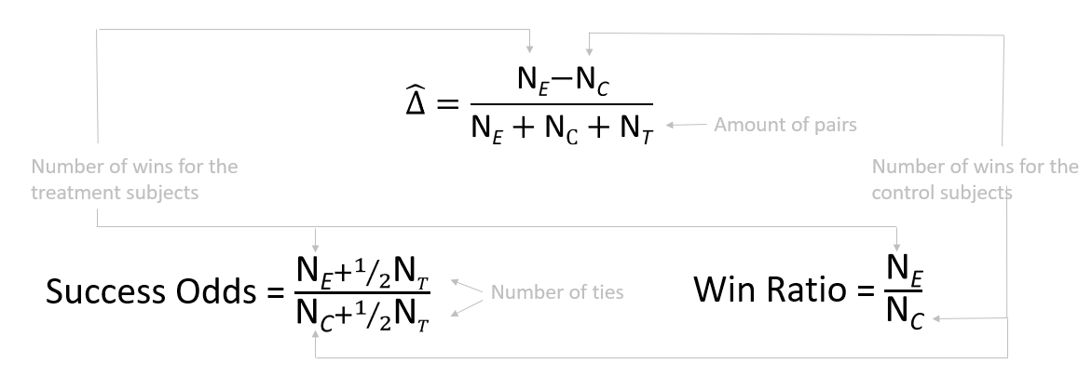
GPC statistics
Note : NTB = (SO-1)/(SO+1)
Buyse. Stat Med (2010) Pocock et al. Eur Heart J (2012) Dong et al. Stat Biopharm Res (2019) Brunner et al. Stat Med (2021)

Slide 28
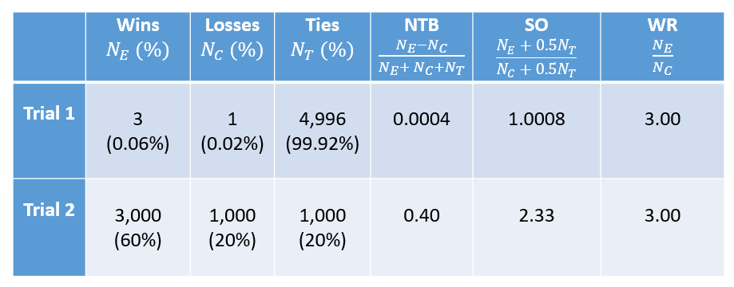
GPC statistics - differences
The WR ignores the ties or redistributes the ties according to the observed win/loss proportions -> overestimation of effect

Slide 29
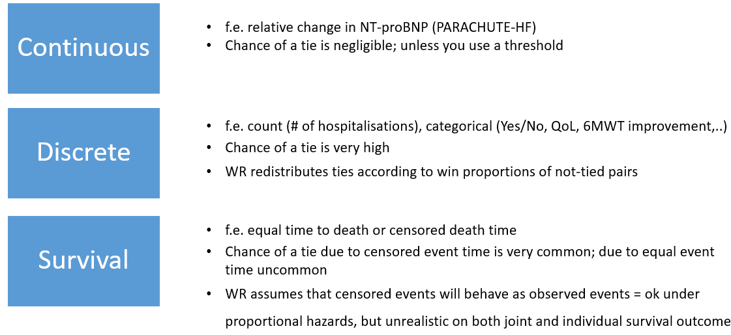
Consequences of redistributing ties

Slide 30
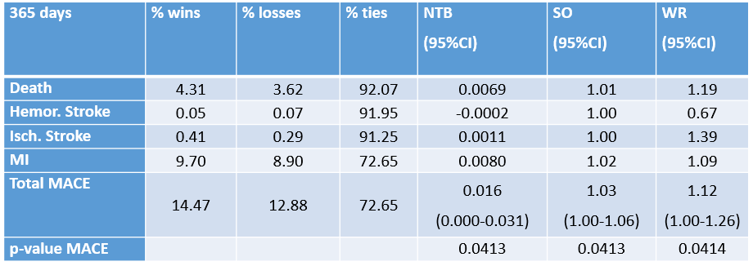
Additive decomposition of NTB

Slide 31
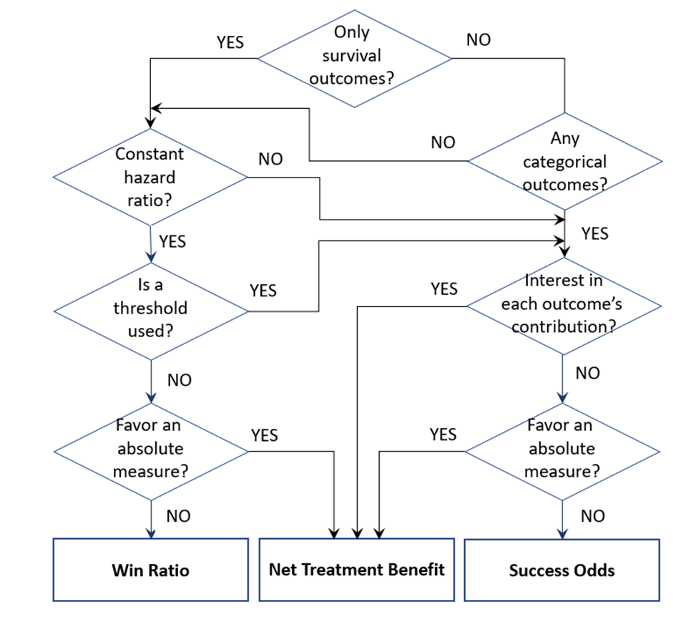
Guidance of GPC measures in clinical trials
Verbeeck et al. JACC (2023)

Slide 32
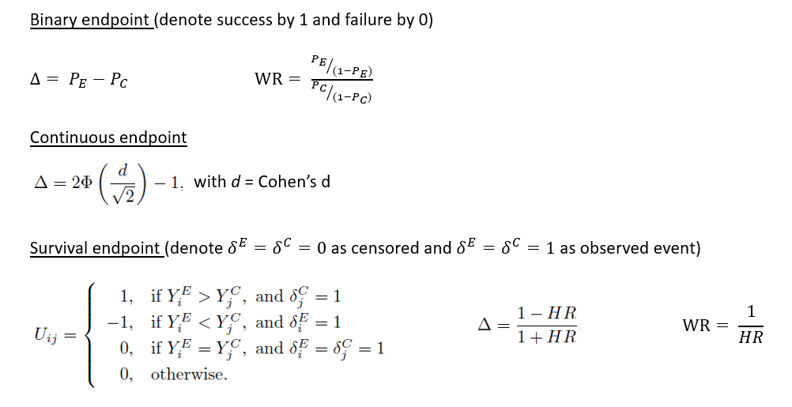
GPC – Links with conventional effect size measures for univariate outcomes
Gehan. Biometrika (1965)
Notes:
diff in prob; odds ratio:

Slide 33
Questions? Break

Slide 34
Software for GPC
Part 1: Measures of treatment effect
code available at https://github.com/bozenne/tutorial-DagStat2025-GPC
file BuyseTest_intro.R
Notes:
+ intro software (10 slides)

Slide 35

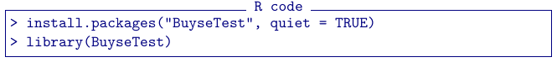

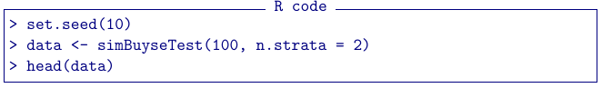
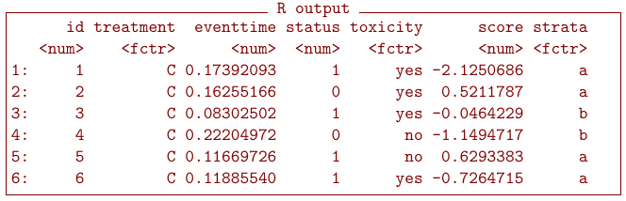
-package: BuyseTest
Installation
(requires internet connection)
Simulate data
100 subjects
2 treatment groups (C or T)
outcomes simulated independently
data.table format
(as.data.frame: convertion to data.frame)
Notes:
Workhorse : BuyseTest: requires a group indicator + outcomes (prioritized) and dataset
Default options via BuyseTest.options

Slide 36
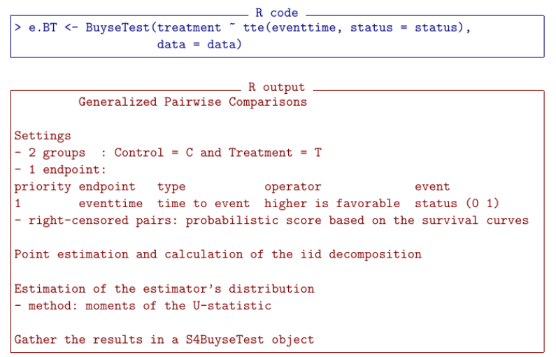
Formula interface
Left hand side: group
Right hand side: outcome(s)
time to event or tte or t
continuous or cont or c
binary or bin or b

Slide 37
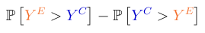
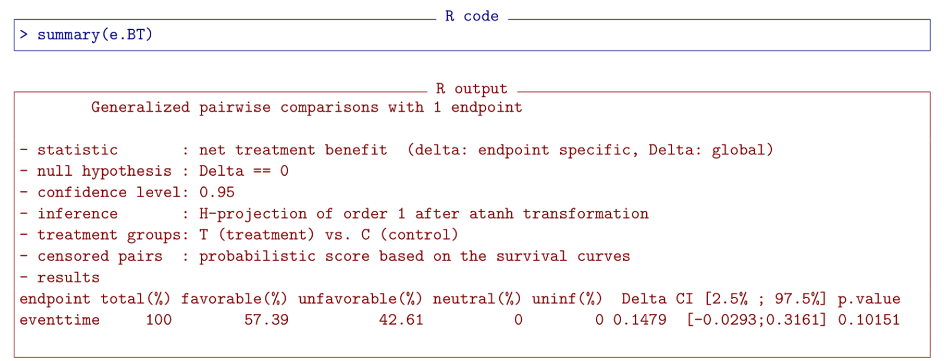
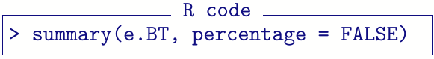
Output of the GPC procedure
Default: net treatment benefit
Display number of pairs instead of %:

Slide 38
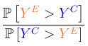
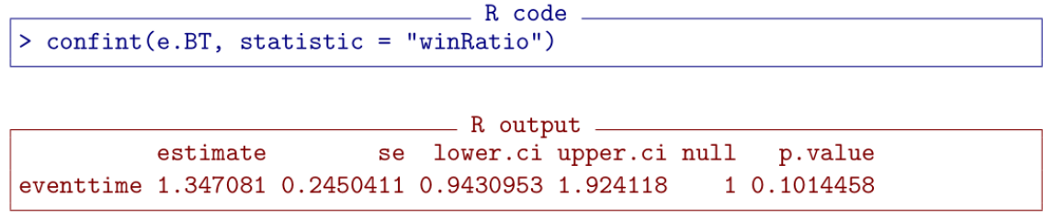
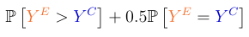
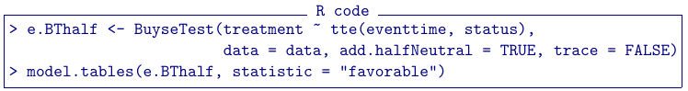

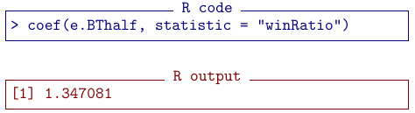
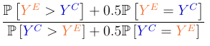
Other measures of treatment effect
Win ratio
argument statistic
Probabilistic index & success odds
re-run GPC adding
the contribution
of neutral pairs
no neutral pairs here
so win ratio = success odds

Slide 39
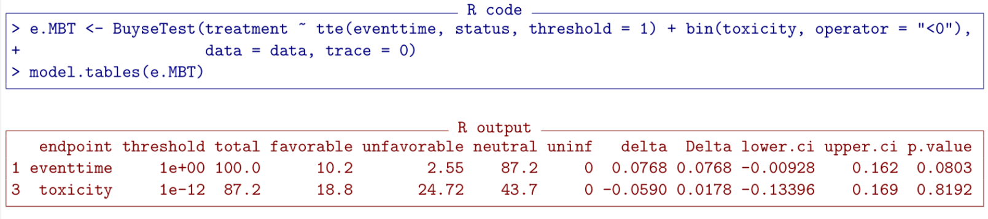
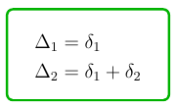
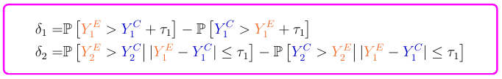
More options
Threshold (𝜏)
time to event outcomes
continuous outcomes
Operator
“<0” lower values are favorable
Multiple outcomes
separated by “+”
priority from left (highest)
to right (lowest)

Slide 40
Software for GPC
Part 2: statistical inference
code available at https://github.com/bozenne/tutorial-DagStat2025-GPC
file BuyseTest_intro.R
Notes:
+ intro software (10 slides)

Slide 41


Inferential methods in Buyse Test
H₀ : F_{e} = F_{c}
outcome distribution
permutation
u-statistic
bootstrap
H₀ : Δ = 0
Net Treatment
Benefit
studentized permutation
studentized bootstrap
u-statistic
+ transformation
no CI but exact
(under exchangeability)
asymptotically valid
studentized: Δ/σ_{Δ}
Anderson & Verbeeck
Mathematics 2023
resampling (slow)
analytic (fast)

Slide 42
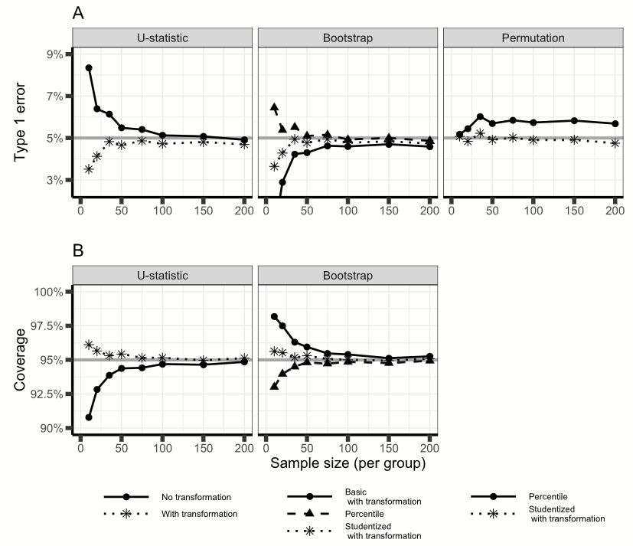
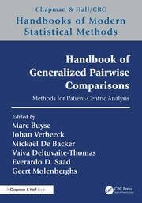
Results from a simulation study
heteroscedastic outcome
From
chapter 3

Slide 43
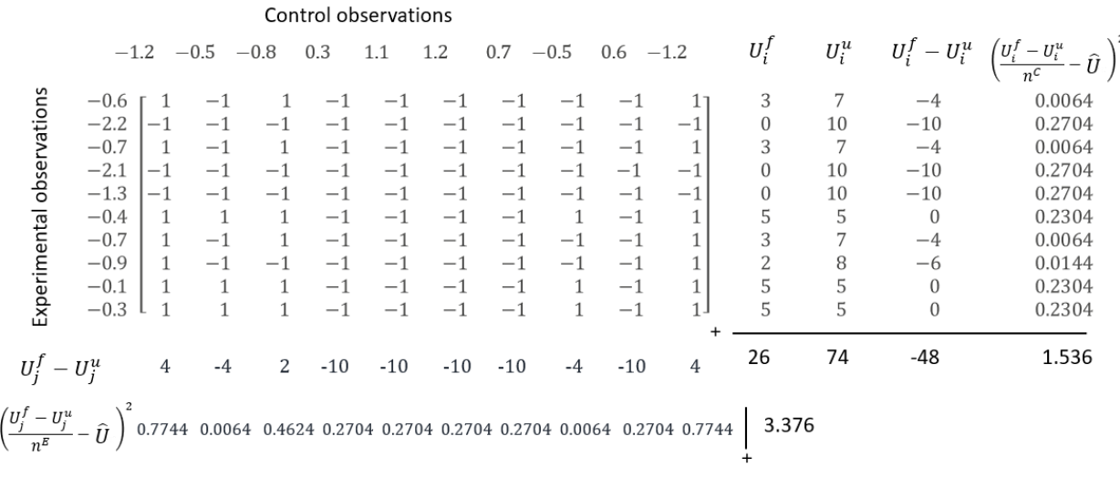
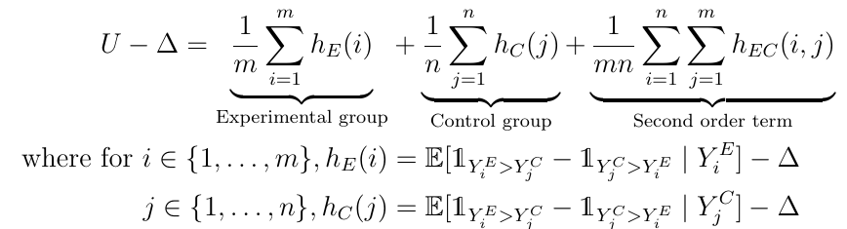
Inference based on U-statistic theory
Toy example
10 observation in each arm
Net Treatment Benefit (Δ)
estimated U=(26-74)/100=-0.48
Theory: H-decomposition
first order: similar to jackknife
second order: asymptotically
neglectable
Ozenne et al. SMMR (2021)

Slide 44

Inference based on U-statistic theory
Variance estimation:
first order:
1.536/100+3.376/100=0.04912
second order:
9*first order/10 + … = 0.0519
second order term in presence of ties
see Brunner et al. Stat. Papers (2025).
Implementation:
combine intermediate results
(nearly no extra calculations)
use tanh⁻¹ transformation to be range preserving (better small sample performance)
2

Slide 45

Inference based on U-statistic theory (code)
1st order H-decomposition
(rescaled)

Slide 46



Inference based on permutations
Using resampling:
Permute the group labels (possibly within strata) in P different ways.
For each estimate the Net Treatment Benefit (Δ^{𝒫(1)},...,Δ^{𝒫(P)})
Evaluate the frequency of a more extreme result
Using an analytic formula (Anderson & Verbeeck, Mathematics, 2023)
matches Wilcoxon’s test p-value (no ties)
assumes normally distributed test statistic
currently only implemented for Gehan’s score
Notes:
Permutation only resampled implemented – not exact
Assume normal distibution of permuted NTB – ok for very small samples

Slide 47

Equivalence GPC and Wilcoxon rank sum test
(without continuity correction)

Slide 48
Argument method.inference in Buyse Test
Possible values:
"none"
"u statistic" (default)
"varexact permutation"
"permutation"
"studentized permutation"
"bootstrap"
"studentized bootstrap"
Additional arguments
transformation (T/F): in follow-up methods (e.g. summary)
n.resampling: number of samples
strata.resampling: stratified resampling
cpus: parallel evaluation
seed: for reproducibility
Change default behavior

Slide 49
Examples revisited

Slide 50

1. Time-to-first revisited: time-to-worst event
Or at least a simulated dataset resembling CHARM preserved (CHARM_sim.csv)
Events in time-to-first composite
Candesartan Placebo
92 (54%) 90 (53%)
241 (100%) 276 (100%)
Notes:
Simulated dataset has the same amount of events as CHARM preserved

Slide 51

Time-to-first vs. time-to-worst event
HR: 0.87 [0.75;1.01]
p-value: 0.0586
Notes:
But as said: we miss 46% of mortality

Slide 52

Time-to-first vs. time-to-worst event

Slide 53

Time-to-first vs. time-to-worst event

Slide 54

Time-to-first vs. time-to-worst event (with threshold)

Slide 55

2. Benefit-Risk assessment revisited
GPC analysis takes multiple prioritized outcomes into account:
Survival gain of at least 6 months
Worse side effect reduction by at least 2 grades
Survival gain of at least 1 month
Any reduction in worse side effect
Such an analysis is more clinical relevant and more powerful
- Illustration using a simulated dataset resembling the prodige trial

Slide 56



Analyses
Marginal
Hazard ratio: 0.778 [0.658,0.920]
Probability of toxicity ≥ 3
53.3% vs 60.6% (p = 0.033)
Joint analysis using GPC

Slide 57
Joint analysis using GPC
(simplified output)
Prioritized
outcomes
Favorable
pairs
Favor
Treatment
Favor
Control
Neutral
Contribution
NTB
Survival
Longer by ≥ 6 months
28.2%
56.2%
15.6%
12.7%
12.7% (P=0.0004)
Toxicity
Lower by 2 grades
10.3%
32.9%
13.0%
-2.7%
10.0% (P=0.012)
Survival
Longer by ≥ 1 month
5.1%
22.8%
5.0%
0.1%
10.1% (P=0.015)
Toxicity
Lower
5.7%
12.3%
4.7%
1.0%
11.1% (P=0.010)
Overall
51.0%
36.6%

Slide 58
GPC analysis of multivariate outcome
11.1% = (28.2% - 15.6%) + (10.3% - 13.0%) + (5.1% - 5.0%) + (5.7% - 4.7%)
NTB = NTB₁ + NTB₂ + NTB₃ + NTB₄
additive contributions of outcomes: facilitates interpretation
NTB₂ , NTB₃ , NTB₄ do not reflect marginal effects
they depends on previous outcomes (probability of neutral pair)
Win Ratio = 49.4% / 38.3% = 1.29
no additive or multiplicative decomposition
difficult to understand the contribution of each outcome

Slide 59




Sensitivity analysis
Sensitivity of the result to the choice of the threshold(s)
in other applications, the choice of the threshold can have substantial impact on the results

Slide 60

Sensitivity analysis

Slide 61

3. EB rare disease trial revisited
16 pediatric subjects treated with placebo and diacerin cream in a longitudinal cross-over trial (14 paired)
Patient-centric analysis: blister count and change in QoL at week 4
Uncertainty in blister counts
Notes:
Only week 4 since, QoL only measured at week 4 + uncertainty count

Slide 62

EB revisited:

Slide 63

EB revisited: Patient-centric outcome

Slide 64





Matched versus unmatched GPC
Konietschke et al. Electron J Stat (2012)
Fay et al. Stat Med. (2018)
Matsouaka SMMR (2022)
Verbeeck et al. OJRD. (2023)
Notes:
MOVER for CI; but not implemented in BuyseTest

Slide 65

EB revisited: Univariate insufficient evidence, but patient-centric analysis shows treatment effect

Slide 66

EB revisited: less evidence for count outcome

Slide 67

EB revisited: accounting for blister uncertainty
Notes:
Theshold = 0.5 (on a std scale: so uncertainty of half of the counts) – the higher the treshold to more you move to binary analysis

Slide 68


EB revisited: CI consistent with p-value in this case
permutation
Notes:
Need to use u-statistic for CI, consistent in this case, not necessarily so.

Slide 69
Questions? Break

Slide 70
Advanced Topics

Slide 71


1. Censoring
End of study
End of study
Dropout censoring
Notes:
2 types of censoring

Slide 72
Gehan scoring rule (recap’)
E
C
U_{ij} = -1
U_{ij} = 0
U_{ij} = 1
informative pairs
E
C
U_{ij} = ?
U_{ij} = ?
U_{ij} = ?
uninformative pairs
analyzed using lower rank outcome(s)

Slide 73



Peron scoring rule (example)
time to event
(right-censored)
event type indicators
Only 1 out 4 individuals in the other group will survive up to the time of the observed event.
No survivor in the other group at the time of the observed event.

Slide 74

Peron scoring rule (formula)
pairwise score
event type indicators
0 censored
1 event
Large right-censored event time for the control arm
Large right-censored event time for the experimental arm
‘Similar’ right-censored event times
Péron et al. SMMR (2016)

Slide 75
Handling right-censoring with BuyseTest
Naïve approaches: (BuyseTest: scoring.rule = "Gehan“)
uninformative pairs = 0
biased but easy to carry out and preserves type 1 error control
Imputation approaches: (BuyseTest: scoring.rule = “Peron”)
estimate a probability per pair based on a survival model
default model: Kaplan-Meier stratified on treatment arm
estimation and uncertainty quantification is more complex
Add-hoc/other approaches: (BuyseTest: correction.uninf=1 or 2)
superior alternatives
Gehan Biometrika (1965)
Péron et al. SMMR (2016)
Ozenne et al. SMMR (2021)
Péron et al. Biom J (2021)

Slide 76




Using build-in imputation approach
store pairwise score (U_{ij})
memory intensive

Slide 77
Several other corrections
See Deltuvaite-Thomas et al. Biometrical journal (2022) for an overview
Naïve approaches:
Gehan: uninformative pairs = 0
Harrell: ignore uninformative pairs
Imputation approaches: survival model
Latta: Kaplan-Meier (common to both arms)
Peron: Kaplan-Meier stratified on treatment arm
Efron: same but constrained to 0 at end of follow-up
De Backer: use extreme value tail model
Weighting approaches: inverse probability of censoring
Datta: pairs with censored event weight 0
Dong: ‘Gehan’-like alternative
Gehan Biometrika (1965)
Harrell et al. JAMA (1982)
Latta Biometrika (1977)
Péron et al. SMMR (2016)
Efron Proc 5th Berkeley Symposium on Math. Stat. and Proba. (1967)
De Backer Pharm Stat. (2023)
Datta et al. Scandinavian Journal of Statistics (2010)
Dong et al. Journal of Biopharmaceutical Statistics (2020)
The Kaplan Meier estimators (S_{KM}(t) event of interest, C_{KM}(t) censoring) satisfy:
S_{KM}(t) . C_{KM}(t) = number still at risk at time t+ / sample size
-> similarities between weighting and imputation: Efron/Datta Peron/Dong

Slide 78
(Personal) critic of the other corrections
implemented in BuyseTest
Naïve approaches:
Gehan: uninformative pairs = 0
Harrell: ignore uninformative pairs
Imputation approaches: survival model
Latta: Kaplan-Meier
Peron: Kaplan-Meier stratified on treatment arm
Efron: same but constrained to 0 at end of follow-up
De Backer: use extreme value tail model
Weighting approaches: inverse probability of censoring
Datta: pairs with censored event weight 0
Dong: ‘Gehan’-like alternative
not implemented in BuyseTest
biased (except PH case)
argument model.tte to provide an adequate survival model
‘discard’ information
equivalent to imputation approach
with un-natural survival models
Useful to handle informative censoring if covariates available
Unclear validity of the extension to multiple, correlated, endpoints

Slide 79

Using your own imputation approach
Latta
prodlim: Kaplan Meier estimator (possibly stratified)
survreg: parametric survival model (possibly with covariates)
rely on numerical integration
Software limitation:
only implemented for survival models with covariates that are constant within the sub-groups formed by the treatment and strata variables.

Slide 80

Performance in presence of drop-out
Reasonable for censoring below 50%
Deltuvaite-Thomas et al. Biometrical journal (2022)

Slide 81
What about administrative censoring?
Real life studies have finite follow-up time
- The tail of the survival function
is not (non-parametrically) identifiable
- May be needed to score some of the pairs!
Possible remedies:
make parametric assumptions (Efron, De Backer, Harrel, …)
switch to an easier estimand: restricted NTB to time 𝛤 (here 𝛤 =24 months)
rNTB = ℙ[min(X,𝛤)>Y] - ℙ[min(Y,𝛤)>X]
Piffoux et al. J Clin Epidemiol (2024)

Slide 82
2. Covariate adjustment
Marginal treatment effect
Expected improvement in population
Simplicity of communication; reduced complexity for combining results; decision making on population level
Conditional treatment effect
Expected improvement conditionally on characteristics shared by individuals
Closer to individual-level effect

Slide 83
Collapsibility
Marginal effect = (weighted) sum of conditional effects in subgroups or individuals
Many treatment effect measures are non-collapsible (OR, HR,..)
GPC treatment effect measures (PI, NTB, WR, SO) are non-collapsible
-> Conditional effects may differ from marginal effects
-> Important to ascertain interest in marginal or conditional effect a priori

Slide 84
Strategies for covariate adjustment in GPC
Stratification
Conditional treatment effects
Non-parametric adjustment
Marginal treatment effect
Semi-parametric models: Generalized PI models (GPIM)
Marginal and conditional effects

Slide 85


Stratification in GPC
Recall the U-statistic
With K strata, this becomes
This U-statistic is a conditional estimate of the NTB, given the strata
Buyse. Stat Med (2010)
Dong et al. Pharmaceutical Statistics (2023)

Slide 86




Choice of weights
Cochran-Mantel-Haenszel (CMH) weights: weights proportional to the ratio of the strata pairs and the observations per strata = best (pool.strata=”CMH”)
Weights proportional to the strata pairs (pool.strata=”buyse”)
Equal weights (pool.strata=”equal”)
Inverse variance weights (pool.strata=”var-netBenefit”)
Buyse. Stat Med (2010)
Dong et al. Pharmaceutical Statistics (2023)

Slide 87

Revisit Prodige trial with sex stratification

Slide 88


Revisit Prodige trial with sex stratification
Explore size of strata and number of pairs
Explore NTB per strata and per endpoint

Slide 89




Non-parametric adjustment
~Augmented estimator, with a term that depends on the covariates and their link with the endpoints
This U-statistic is a marginal estimate of the NTB
Koch et al. Stat Med (1998)

Slide 90


Alternative: standardization
For non-continuous baseline covariates
The average absolute difference between the non-parametric adjustment and standardization is of the order .

Slide 91


Slide 92



GPIM : Conditional Models
1. Thas et al. J R Stat Soc Series B Stat Methodol. (2012)
2. Zhang et al. International Statistical Review (2019)
3. Mao et al. Biometrics (2021)
4. Jaspers et al. Stat. Med. (2024)
Notes:
Any link function can be taken
PIM: Jackknife empirical likeliihood
Mao extended conditional models to very specific limitations of proportional win fractions

Slide 93




Conditional Models: pim package
Childhood Respiratory Disease Study (CRDS) follows the pulmonary function (FEV) in 654 children of ages 3−19.
Interest: effect of smoking on FEV, corrected for age
Rosner Fundamentals of Biostatistics. (1999)
Notes:
forced expiratory volume (FEV), which is an index of pulmonary function measured = the volume of air expelled after one second of constant effort

Slide 94




Conditional Models: small sample pim
Leveraging small sample GEE -corrections
Jaspers et al. Stat. Med. (2024)
Notes:
Pyridie: toxic product causing liver, kidney and CNS issues + decreased gain in weiht
GEE with Morel small sample + Firth correction
Pairwise comparing doses + adjusted p-values Bnjamini-Hochberg
<50% meaning larger dose leads to lower gain in weight

Slide 95
Marginal Models
Single outcome:
Regression imputation estimator¹
Inverse probability of treatment weighted (IPTW) estimator²⁻⁴
Working on extensions to multivariate outcomes
1. Vermeulen et al. Stat Med. (2015)
2. Vermeulen et al. Int J Biostat. (2016)
3. Mao et al. Biometrika (2018)
4. Zhang et al. International Statistical Review (2019)
Notes:
in many studies the research question does not involve covariates, such that the natural effect size is of a marginal nature.

Slide 96
Designing a Trial

Slide 97

Example of a non-inferiority trial
De Backer, Clin Trials (2024)
Aim:
Obtain approval for a as effective but safer drug
e.g. Acute Promyelocytic Leukemia: reduced dose treatment vs. full dose
Traditionally
Primary endpoint: Event-Free Survival (EFS) at 2 years
-> Expensive: large sample size required to meet a ‘narrow’ non-inferiority margin
-> Inefficient: key toxicity outcomes are relegated to secondary analyses
Does not answer the clinical question: “which drug patients are better off”
Can produce results where the reduced dose is less toxic and
the full dose does not lead to statistically superior survival,
yet one does not have convincing evidence for non-inferiority.
Laken et al., AMPPS (2018)

Slide 98
Benefit-risk assessment using GPC
Prioritized outcomes:
Event free survival with the non-inferiority margin as threshold (e.g. 1 month)
Severe side effects (e.g. grade 3 or 4)
… any other outcome relevant for the patient or regulator.
Toxicity is only investigated among pairs of patients with similar survival
order of the outcomes reflects their importance
accounts for potential degradation of the survival with the reduced dose
Testing Net Treatment Benefit for reduced vs. full dose:
more meaningful: Does benefit-risk balance favor reduced dose?
typically better powered
Tannock et. al, Lancet Oncol 2024

Slide 99

De Backer, Clin Trials (2024)

Slide 100
Challenges in designing trials with GPC
Definition of the estimand:
ordering of the outcomes
threshold(s) of clinical relevance
encoding of the outcome: typically more neutral pairs when categorical vs. continuous
more neutral pairs => more weight for later outcomes
interim analyses may lead to different estimands, e.g. with survival as first outcome more neutral pairs at interim compared to final due to shorter follow-up time
Simulations studies are typically required
GPC being non-parametric: no explicit formula except special cases
joint distribution required: hypothesis on the outcome dependence structure

Slide 101


Power/sample size calculation with BuyseTest
Step 1: define the data-generating mechanism via a function
generate a data.frame, one row per subject, one column for group and for each outcome
simplistic example with independent outcomes
no censoring, no terminal event
data.frame
format

Slide 102


Power calculation with BuyseTest
Step 2: use the function powerBuyseTest to evaluate rejection rate
under the proposed data generating mechanism
number of simulations used to estimate the rejection rate

Slide 103


Sample size calculation with BuyseTest
Step 2: use the function powerBuyseTest to approximate the sample size
(based on an asymptotic approximation, no accurate when only a sample sample is needed)
10 large datasets
(default n=m=2000) used to estimate the asymptotic variance
1000 simulations used to estimate the rejection rate

Slide 104
GPC in a nutshell
Principled way to combine outcomes of different nature
hierarchy, threshold of clinical relevant, restriction time
require careful considerations and discussion
to address a pertinent clinical question
patient centric: what treatment benefits most the patient
while understanding the impact of each outcome
Net Treatment Benefit as an interpretable and additive effect measure
A ‘mature’ framework that can handle many of the usual complications
right-censoring, competing risks, covariates, multiple testing
The package BuyseTest attempts to provide a convenient & transparent interface
despite remaining open questions
interim analyses, non-transitivity with >2 groups, correlated right-censored outcomes, …

Slide 105

Brice Ozenne PhD
brice.ozenne@nru.dk
Biostatistics & Neurobiology Research Unit
University of Copenhagen- Denmark
Johan Verbeeck PhD
johan.verbeeck@uhasselt.be
Data Science Institute
UHasselt - Belgium

Slide 106
Bibliography (1/6)
Anderson,W.N.; Verbeeck, J. Exact Permutation and Bootstrap Distribution of Generalized Pairwise Comparisons Statistics. Mathematics
2023, 11, 1502. https://doi.org/10.3390/math11061502
Buyse M. Generalized pairwise comparisons of prioritized outcomes in the two-sample problem. Stat Med. 2010 Dec 30;29(30):3245-57. doi: 10.1002/sim.3923.
Brunner E, Vandemeulebroecke M, and Mütze T. Win odds: An adaptation of the win ratio to include ties. Statistics in Medicine. 2021; 40, 3367–3384.
Brunner, E., Konietschke, F. An unbiased rank-based estimator of the Mann–Whitney variance including the case of ties. Stat Papers 66, 20 (2025). https://doi.org/10.1007/s00362-024-01635-0
DATTA, S., BANDYOPADHYAY, D. and SATTEN, G.A. (2010), Inverse Probability of Censoring Weighted U-statistics for Right-Censored Data with an Application to Testing Hypotheses. Scandinavian Journal of Statistics, 37: 680-700. https://doi.org/10.1111/j.1467-9469.2010.00697.x
De Backer M, Legrand C, Péron J, Lambert A, Buyse M. On the use of extreme value tail modeling for generalized pairwise comparisons with censored outcomes. Pharmaceutical Statistics. 2023; 22(2): 284-299. doi:10.1002/pst.2271
De Backer M, Sengar M, Mathews V, et al. Design of a clinical trial using generalized pairwise comparisons to test a less intensive treatment regimen. Clinical Trials. 2024;21(2):180-188. doi:10.1177/17407745231206465
Deltuvaite-Thomas, V., Verbeeck, J., Burzykowski, T., Buyse, M., Tournigand, C., Molenberghs, G., & Thas, O. (2023). Generalized pairwise comparisons for censored data: An overview. Biometrical Journal, 65, 2100354. https://doi.org/10.1002/bimj.202100354

Slide 107
Bibliography (2/6)
Dong G, Hoaglin DC, Qiu J, Matsouaka RA, Chang YW, Wang J, Vandemeulebroecke M. The Win Ratio: On Interpretation and Handling of Ties. Statistics in Biopharmaceutical Research. 2019; 12(1), 99–106. https://doi.org/10.1080/19466315.2019.1575279
Dong Gaohong, Mao Lu , Huang Bo, Gamalo-Siebers Margaret , Wang Jiuzhou, Yu GuangLei & Hoaglin David C. (2020) The inverse-probability-of-censoring weighting (IPCW) adjusted win ratio statistic: an unbiased estimator in the presence of independent censoring, Journal of Biopharmaceutical Statistics, 30:5, 882-899, DOI:10.1080/10543406.2020.1757692
Dong G, Hoaglin DC, Huang B, Cui Y, Wang D, Cheng Y, Gamalo-Siebers M. The stratified win statistics (win ratio, win odds, and net benefit). Pharm Stat. 2023 Jul-Aug;22(4):748-756. doi: 10.1002/pst.2293.
Efron, Bradley, The two sample problem with censored data, Berkeley Symp. on Math. Statist. and Prob., 1967 5.4: 831-853 (1967)
Fay MP, Brittain EH, Shih JH, Follmann DA, Gabriel EE. Causal estimands and confidence intervals associated with Wilcoxon-Mann-Whitney tests in randomized experiments. Stat Med. 2018 Sep 10;37(20):2923-2937. doi: 10.1002/sim.7799.
Gehan, Edmund A. “A Generalized Two-Sample Wilcoxon Test for Doubly Censored Data.” Biometrika 52, no. 3/4 (1965): 650–53. https://doi.org/10.2307/2333721.
Hoeffding W. A Class of Statistics with Asymptotically Normal Distribution. Ann. Math. Statist. 1948 Sept; 19 (3): 293 - 325. https://doi.org/10.1214/aoms/1177730196
Jaspers S, Verbeeck J, Thas O. Covariate-adjusted generalized pairwise comparisons in small samples. Statistics in Medicine. 2024; 43(21): 4027-4042. doi: 10.1002/sim.10140

Slide 108
Bibliography (3/6)
Koch GG, Tangen CM, Jung JW, Amara IA. Issues for covariance analysis of dichotomous and ordered categorical data from randomized clinical trials and non-parametric strategies for addressing them. Stat Med. 1998 Aug 15-30;17(15-16):1863-92. doi: 10.1002/(sici)1097-0258(19980815/30)17:15/16<1863::aid-sim989>3.0.co;2-m.
Konietschke F, Hothorn LA, Brunner E. Rank-based multiple test procedures and simultaneous confidence intervals. Electron. J. Statist. 2012; 6: 738 - 759. https://doi.org/10.1214/12-EJS691
Lakens D, Scheel AM, Isager PM. Equivalence Testing for Psychological Research: A Tutorial. Advances in Methods and Practices in Psychological Science. 2018;1(2):259-269. doi:10.1177/2515245918770963
Mann HB, Whitney, DR. On a Test of Whether one of Two Random Variables is Stochastically Larger than the Other. The Annals of Mathematical Statistics. 1947; 18(1), 50–60.
Mao L. On causal estimation using U-statistics. Biometrika. 2018; 105(1): 215–220, https://doi.org/10.1093/biomet/asx071
Mao L, Wang T. A class of proportional win-fractions regression models for composite outcomes. Biometrics. 2021; 77: 1265–1275. https://doi.org/10.1111/biom.13382
Matsouaka RA. Robust statistical inference for matched win statistics. Stat Methods Med Res. 2022 Aug;31(8):1423-1438. doi: 10.1177/09622802221090761.

Slide 109
Bibliography (4/6)
O'Brien PC. Procedures for comparing samples with multiple endpoints. Biometrics. 1984 Dec;40(4):1079-87.
Ozenne B, Budtz-Jørgensen E, Péron J. The asymptotic distribution of the Net Benefit estimator in presence of right-censoring. Stat Methods Med Res. 2021 Nov;30(11):2399-2412. doi: 10.1177/09622802211037067
Péron J, Buyse M, Ozenne B, Roche L, Roy P. An extension of generalized pairwise comparisons for prioritized outcomes in the presence of censoring. Stat Methods Med Res. 2018 Apr;27(4):1230-1239. doi: 10.1177/0962280216658320
Péron J, Giai J, Maucort-Boulch D, Buyse M. The Benefit-Risk Balance of Nab-Paclitaxel in Metastatic Pancreatic Adenocarcinoma. Pancreas. 2019 Feb;48(2):275-280. doi: 10.1097/MPA.0000000000001234
Péron J, Idlhaj M, Maucort-Boulch D, Giai J, Roy P, Collette L, Buyse M, Ozenne B. Correcting the bias of the net benefit estimator due to right-censored observations. Biom J. 2021 Apr;63(4):893-906. doi: 10.1002/bimj.202000001
Piffoux M, Ozenne B, De Backer M, Buyse M, Chiem JC, Péron J. Restricted Net Treatment Benefit in oncology. J Clin Epidemiol. 2024 Jun;170:111340. doi: 10.1016/j.jclinepi.2024.111340
Pocock SJ, Ariti CA, Collier TJ, Wang D. The win ratio: a new approach to the analysis of composite endpoints in clinical trials based on clinical priorities. Eur Heart J. 2012 Jan;33(2):176-82. doi: 10.1093/eurheartj/ehr352.
Rosner BA. Fundamentals of Biostatistics. Boston :Brooks/Cole, Cengage Learning, 1999.

Slide 110
Bibliography (5/6)
Tannock IF, Buyse M, De Backer M, Earl H, Goldstein DA, Ratain MJ, Saltz LB, Sonke GS, Strohbehn GW. The tyranny of non-inferiority trials. Lancet Oncol. 2024 Oct;25(10):e520-e525. doi: 10.1016/S1470-2045(24)00218-3
Thas O, Neve JD, Clement L, Ottoy JP. Probabilistic index models. Journal of the Royal Statistical Society: Series B.2012; 74: 623-671. https://doi.org/10.1111/j.1467-9868.2011.01020.x
Verbeeck J, De Backer M, Verwerft J, Salvaggio S, Valgimigli M, Vranckx P, Buyse M, Brunner E. Generalized Pairwise Comparisons to Assess Treatment Effects: JACC Review Topic of the Week. J Am Coll Cardiol. 2023 Sep 26;82(13):1360-1372. doi: 10.1016/j.jacc.2023.06.047.
Verbeeck J, Dirani M, Bauer JW, Hilgers RD, Molenberghs G, Nabbout R. Composite endpoints, including patient reported outcomes, in rare diseases. Orphanet J Rare Dis. 2023 Sep 1;18(1):262. doi: 10.1186/s13023-023-02819-x.
Verbeeck J, Saad ED. Rethinking survival analysis: advancing beyond the hazard ratio? Eur Heart J Acute Cardiovasc Care. 2024 Mar 11;13(3):313-315. doi: 10.1093/ehjacc/zuae017.
Vermeulen K, Thas O, Vansteelandt S. Increasing the power of the Mann-Whitney test in randomized experiments through flexible covariate adjustment. Statist. Med. 2015; 34: 1012–1030. doi: 10.1002/sim.6386
Vermeulen K, Vansteelandt S. Data-Adaptive Bias-Reduced Doubly Robust Estimation. The International Journal of Biostatistics. 2016; 12(1): 253-282. https://doi.org/10.1515/ijb-2015-0029

Slide 111
Bibliography (6/6)
Von Hoff DD, Ervin T, Arena FP, Chiorean EG, Infante J, Moore M, Seay T, Tjulandin SA, Ma WW, Saleh MN, Harris M, Reni M, Dowden S, Laheru D, Bahary N, Ramanathan RK, Tabernero J, Hidalgo M, Goldstein D, Van Cutsem E, Wei X, Iglesias J, Renschler MF. Increased survival in pancreatic cancer with nab-paclitaxel plus gemcitabine. N Engl J Med. 2013 Oct 31;369(18):1691-703. doi: 10.1056/NEJMoa1304369
Wally V, Hovnanian A, Ly J, Buckova H, Brunner V, Lettner T, Ablinger M, Felder TK, Hofbauer P, Wolkersdorfer M, Lagler FB, Hitzl W, Laimer M, Kitzmüller S, Diem A, Bauer JW. Diacerein orphan drug development for epidermolysis bullosa simplex: A phase 2/3 randomized, placebo-controlled, double-blind clinical trial. J Am Acad Dermatol. 2018 May;78(5):892-901.e7. doi: 10.1016/j.jaad.2018.01.019.
Wilcoxon F. Individual Comparisons by Ranking Methods. Biometrics Bulletin. 1945; 1(6): 80–83. https://doi.org/10.2307/3001968
Yusuf S, Pfeffer MA, Swedberg K, Granger CB, Held P, McMurray JJ, Michelson EL, Olofsson B, Ostergren J; CHARM Investigators and Committees. Effects of candesartan in patients with chronic heart failure and preserved left-ventricular ejection fraction: the CHARM-Preserved Trial. Lancet. 2003 Sep 6;362(9386):777-81. doi: 10.1016/S0140-6736(03)14285-7.
Zhang Z, Ma S, Shen C, Liu C. Estimating Mann–Whitney-type Causal Effects. International Statistical Review. 2019; 87: 514–530. https://doi.org/10.1111/insr.12326.

